Slide 1
Decision Tree - CART

Slide 2
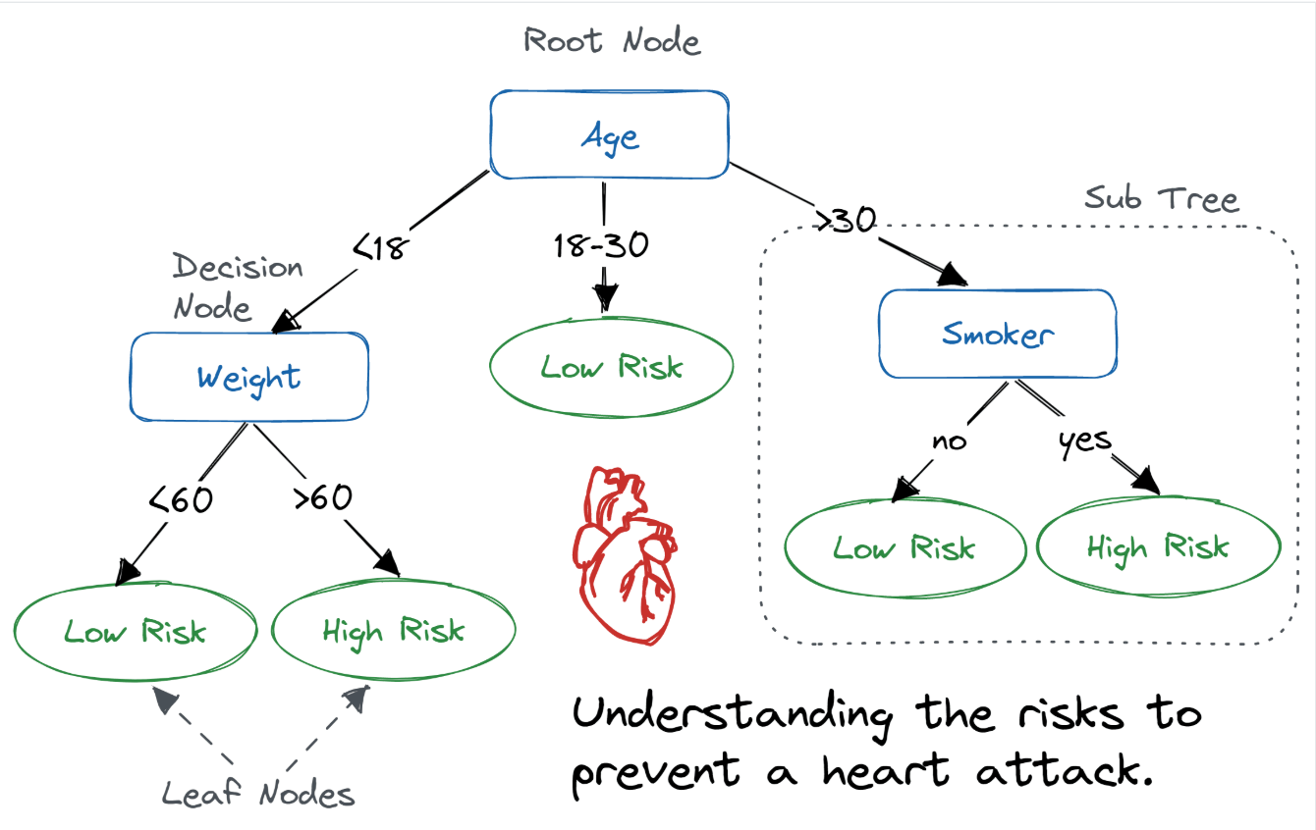

Slide 3
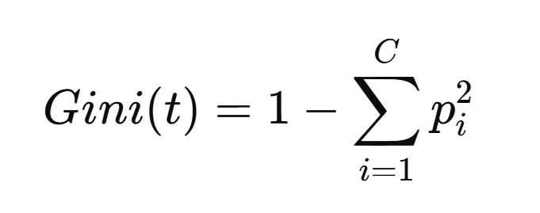

Slide 4


